Slide 1

IMPROVISING CLINICAL TRIAL RECRUITMENT PROCESS
GROUP 9
A041: RISHABH PANDEY
A042: KEYUR PARKHI
A043: DARSHANA PARLE
A044: GAUTAMI PATANKAR
A046: NIRAJ PATIL

Slide 2
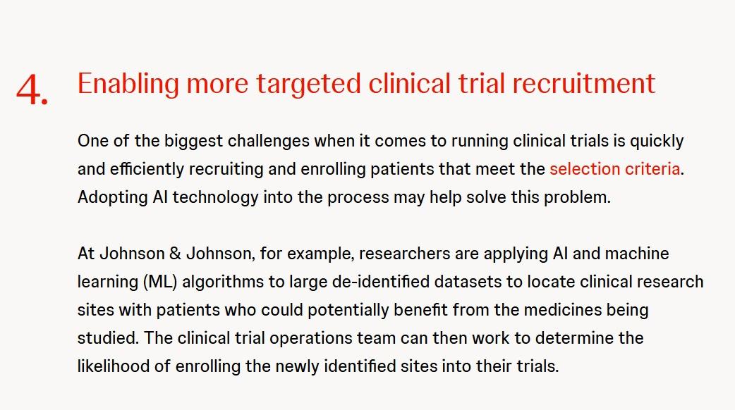

Introduction
Clinical Trials: A Step in Advancement
Clinical trials advance medical practices by testing new treatments, detections, or preventions.
They lead to improved medications, improved care accessibility, and enhanced imaging techniques.
Despite benefits, trials struggle to meet patient recruitment goals, causing delays, increased costs, underpowered results, and study cancellations.
Automated clinical trial matching could expedite recruitment.
Initial efforts involve linking synthetic electronic health records to trial eligibility criteria using natural language processing.

Slide 3
Objectives
Generating High-Fidelity Synthetic EHR Data for Privacy-Preserving Insights
Structuring Unstructured Data for Enhanced Predictive Modeling: Implementing an Ensemble Approach for Improved Insights
Utilizing NLP Models to Match EHR Data with Clinical Trial Inclusion-Exclusion Criteria

Slide 4
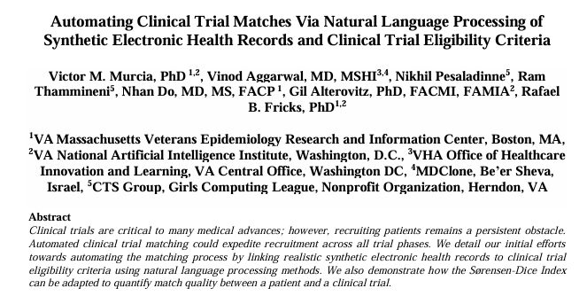
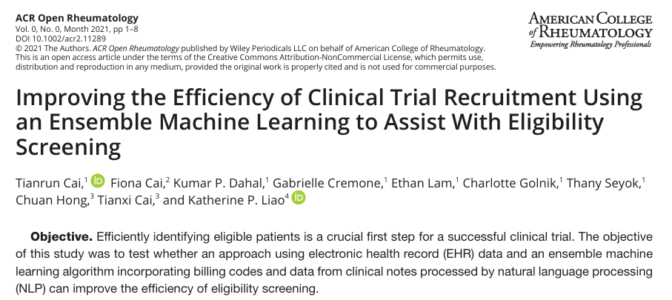
Literature Review
Cai T, Cai F, Dahal KP, Cremone G, Lam E, Golnik C, Seyok T, Hong C, Cai T, Liao KP. Improving the Efficiency of Clinical Trial Recruitment Using an Ensemble Machine Learning to Assist With Eligibility Screening. ACR Open Rheumatol. 2021 Sep;3(9):593-600. doi: 10.1002/acr2.11289. Epub 2021 Jul 23. PMID: 34296815; PMCID: PMC8449035.E
Murcia VM, Aggarwal V, Pesaladinne N, Thammineni R, Do N, Alterovitz G, Fricks RB. Automating Clinical Trial Matches Via Natural Language Processing of Synthetic Electronic Health Records and Clinical Trial Eligibility Criteria. AMIA Jt Summits Transl Sci Proc. 2024 May 31;2024:125-134. PMID: 38827083; PMCID: PMC11141802.

Slide 5
Data Generation using Synthea
SYNTHEA:
Synthea is an open-source, synthetic patient generator that simulates the medical history of patients. It's designed to produce realistic, longitudinal (over time) healthcare data that is privacy-preserving.
WHY?
Overcoming Real-World Data Challenges
Customization for Clinical Research
Scalability & Cost Efficiency
Interoperability & Standardization

Slide 6
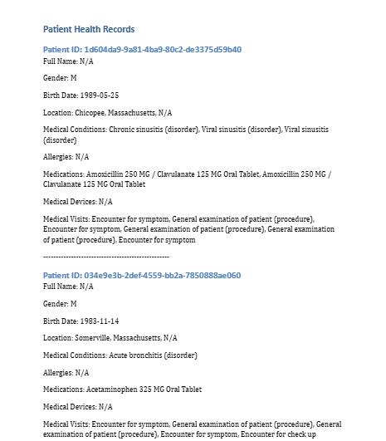





Data Generation using Synthea
Prepare Your Environment
To begin, you need to set up your computer to support Synthea. This involves installing some basic tools
Get the Synthea Software:
This is done by downloading it from its public repository (GitHub). Once downloaded, you’ll have access to all the component
rules
Configure the Simulation:
Before generating data, we customize how you want it to behave:
how many patients, geographic location, disease progression modules
Run the Simulation and Export the Data:
Exports structured records in CSV, JSON, FHIR,
and CCDA Supports integration with NLP models
for clinical trial matching

Slide 7
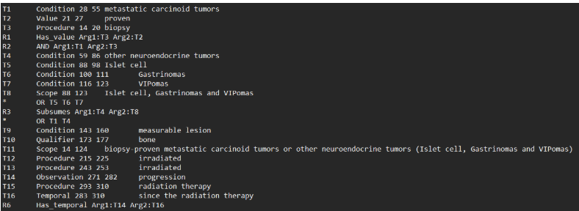
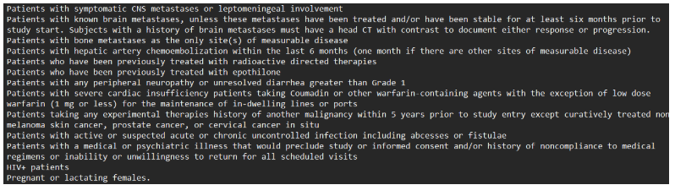
Data Description
CHIA with Scope: Clinical Trial Eligibility Data
Structured, annotated corpus for biomedical NLP, focusing on clinical trial eligibility.
From ClinicalTrials.gov (NCT numbers).
Includes text and BRAT annotations for inclusion and exclusion criteria.
Manually labeled biomedical entities crucial for clinical decisions.
Supports Named Entity Recognition (NER) for trial texts.

Slide 8
Data Description
with Scope: Contextual Understanding
CHIA: Clinical Health Information Annotation
"with Scope" provides contextual labels (inclusion/exclusion) for entities.
Annotates CONDITION, TREATMENT, MEASUREMENT, DEMOGRAPHIC, INCLUSION, EXCLUSION.
Character-level annotations for precise NER training.
Enables nuanced understanding of trial eligibility logic.
Vital for patient-trial matching and intelligent systems.
Valuable for training advanced models like BioBERT for clinical NLP.

Slide 9
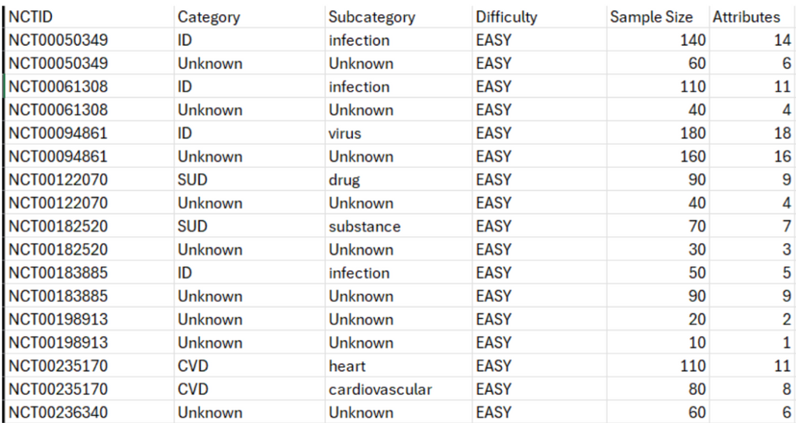
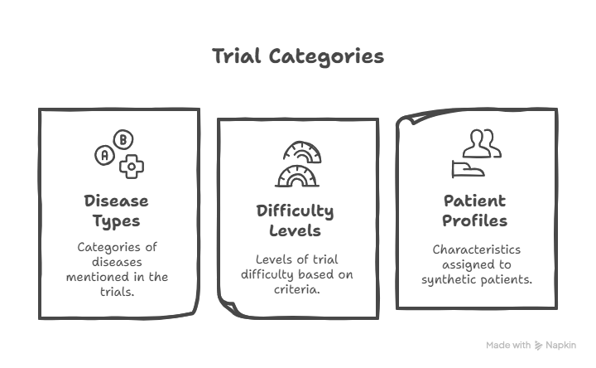
Data Preparation
Basic properties of initial set of a fewclinical trials used to build synthetic patient cohorts.

Slide 10

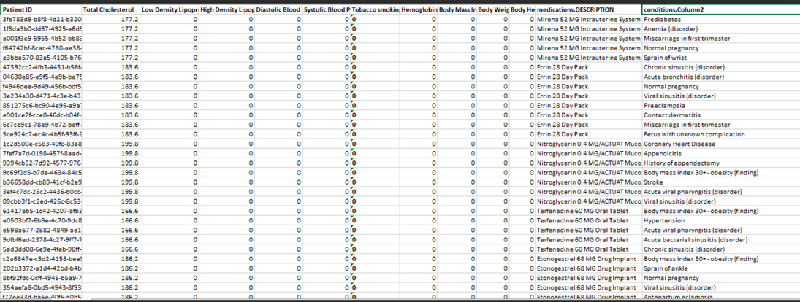
Working on Structured Data

Slide 11
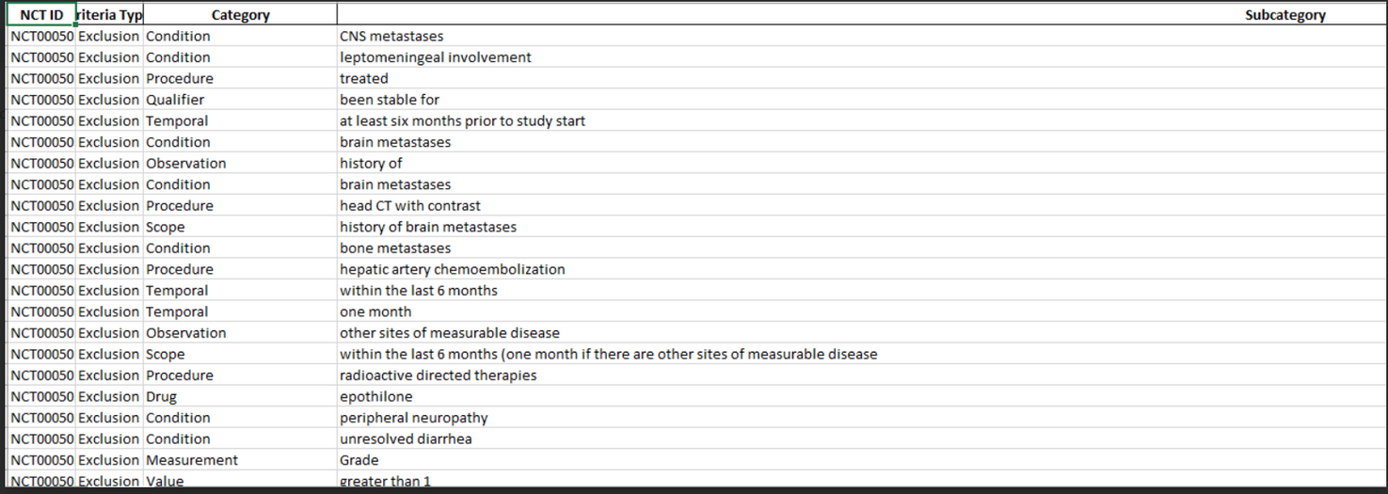
Working on Structured Data

Slide 12
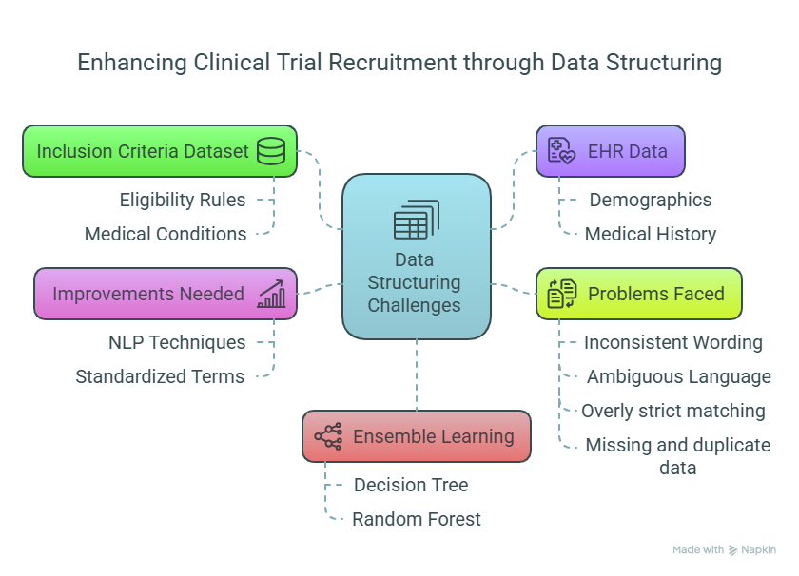
Working on Structured Data

Slide 13
Working on Structured Data
Conclusion
The whole process showed us how difficult it is to work with unstructured EHR data and why just converting it into tables isn’t enough. There are logical gaps, language variations, and context issues that break the matching system. Machine learning, especially ensemble learning, helps us learn these patterns from the data and improves recruitment prediction. But for that, accurate structuring and contextual understanding is still the most important step.
This project clearly highlights that:
Structuring unstructured data is not just about format, it’s about understanding what the data means.
Errors in structuring directly affect machine learning results.
We need better tools like NLP and smarter models to make clinical trial recruitment efficient and reliable.
What Needs to Be Improved
Advanced NLP: Employ entity recognition, negation handling, and synonym matching.
Standardized Terminology: Utilize UMLS or SNOMED CT for consistent medical terms.
Contextual Understanding: Incorporate time-based logic and temporal reasoning.
Machine Learning Models: Train on structured data for automated pattern recognition.

Slide 14
BERT
What is BERT ?
BERT is a deep learning model for Natural Language Processing (NLP) developed by Google AI in 2018. It is built on the Transformer encoder and is designed to deeply understand the context of a word based on both the left and right sides of a sentence — hence, bidirectional
Example: In the sentence: “She went to the bank to deposit money.”
Input Format :
Tokens:
[CLS]: Special token added at the start of input. Used for classification tasks.
[SEP]: Separator token used between two segments (like question and answer)
[CLS] Sentence A [SEP] Sentence B [SEP]
Embeddings:
a. Token Embeddings
These come from BERT’s vocabulary (WordPiece tokenizer). Each word (or subword like “##ing”) is converted to a vector.
b. Segment Embeddings
Help BERT know which sentence a word belongs to.
Sentence A gets Segment ID 0, Sentence B gets Segment ID 1.
c. Position Embeddings
Since Transformers don’t process words in order like RNNs, position embeddings tell BERT where each
word is in the sentence (1st word, 2nd word, etc.).

Slide 15
Named Entity Recognition
Named Entity Recognition (NER) is a fundamental task in Natural Language Processing (NLP) that involves identifying and classifying key information (entities) in text into predefined categories.
How NER Works
1. Text Preprocessing
Tokenization: Splits text into words, phrases, or sentences.
Part-of-Speech tagging (optional).
Lowercasing, punctuation removal (depending on approach).
2. Entity Detection
NER models label each token using a sequence tagging scheme:
BIO format (most common):
B- → Beginning of an entity
I- → Inside an entity
O → Outside an entity
3. Entity Classification
Once entities are extracted, they are classified into categories like PERSON, LOCATION, MEDICATION, CONDITION, etc.

Slide 16
BioBert-NER
Patients EHR
Trial Protocals
Input
Processing
BioBert NER
Entity Extraction
Semantic Embeddings
SDI Clculation
Output
Match Strength
Ranked Trials

Slide 17

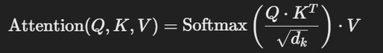
BioBert-NER
EXAMPLE:
“PATIENT HAS TYPE 2 DIABETES AND IS TAKING METFORMIN”
WORKING:
1.Creating tokens
tokens:["[CLS]", "Patient", "has", "Type", "2", "Diabetes", "and", "is", "taking", "Met", "##formin", ".", "[SEP]"]
3.Transformer layers
a. Self-Attention & Layer Normalization
b. Feed-Forward Network
2.Embedding
Each token is converted into a vector using the BioBERT embedding layer

Slide 18
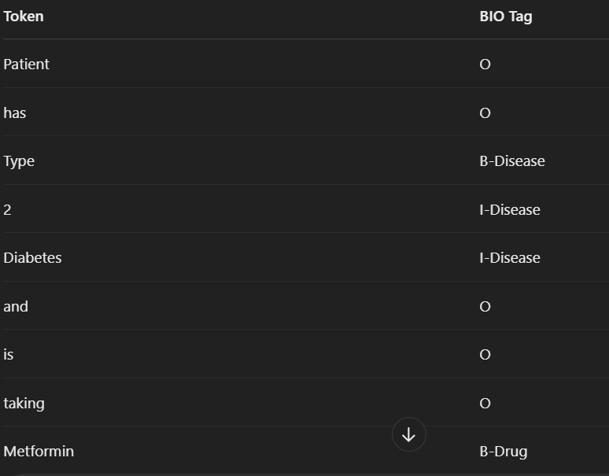
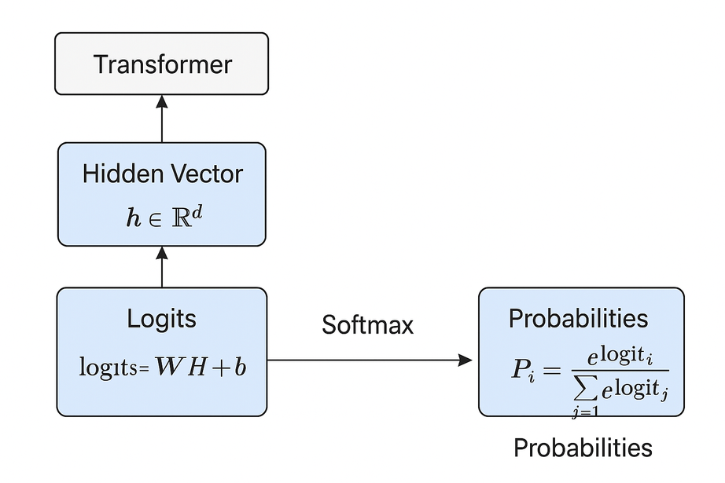
BioBert-NER
EXAMPLE:
“PATIENT HAS TYPE 2 DIABETES AND IS TAKING METFORMIN”
WORKING:
4.NER Classification Head
Logits = W (5x768) × h (768x1) + b (5x1)

Slide 19
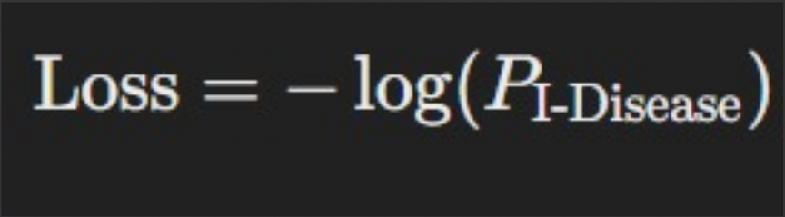
Loss Function
EXAMPLE:
“PATIENT HAS TYPE 2 DIABETES AND IS TAKING METFORMIN”
Token | BIO Tag | Label | Logit | Softmax Prob | Cross-Entropy Loss
Diabetes | I-Disease | B-Disease | 2.5 | 0.182
 |  | I-Disease | 3.8 | 0.719 | -log(0.719)≈0.330
 |  | B-Drug | 0.9 | 0.058
 |  | I-Drug | 0.4 | 0.034
 |  | O(Other) | 0.3 | 0.007

Slide 20


BioBert-NER
Ground Truth Entities
Token Label
Type B : Disease
2 I: : Disease
Diabetes I : Disease
Met B : Drug
##formin I: Drug
Model Prediction:
Token Predicted Label Correct?
Type B : Drug
=False Positive (FP)
2 I : Disease
Diabetes I : Disease
Met B : Drug
##formin O (missed)
=False Negative

Slide 21
BioBert-NER
OVERALL RESULTS
EPOCH | TRAINING | VALIDATION LOSS | PRECISION | RECALL | F1
1 | 1.652300 | 1.482739 | 0.647136 | 0.601108 | 0.623411
2 | 1.334700 | 1.333021 | 0.683438 | 0.653379 | 0.668007
3 | 1.124700 | 1.2131295 | 0.703208 | 0.673137 | 0.688225

Slide 22
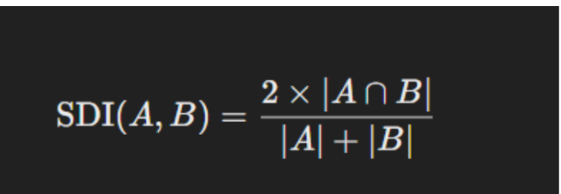
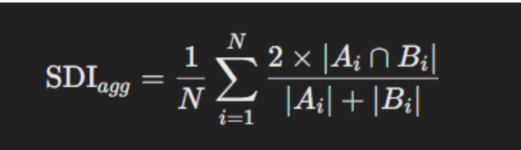
BioBert-NER
To compute the similarity between a patient and a clinical trial, we used the basic Sørensen–Dice Index formula:
AGREGATED SDI
A is the set of attributes from the patient profile
N is the total number of shared keys in both dictionaries, and Ai and Bi represent the sets (True/False values) for a particular entity from the patient and clinical trial profile, respectively
B is the set of entities extracted from the clinical trial criteria
The index returns a score between 0 and 1, indicating the proportion of shared features.

Slide 23
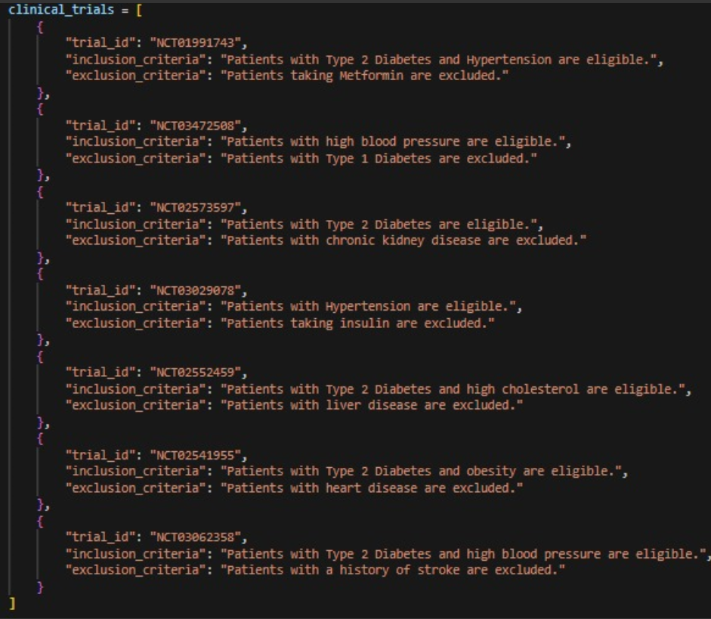
BioBert-NER
EXAMPLE:
“PATIENT HAS TYPE 2 DIABETES AND IS TAKING METFORMIN”
FINDING THE BEST MATCH

Slide 24
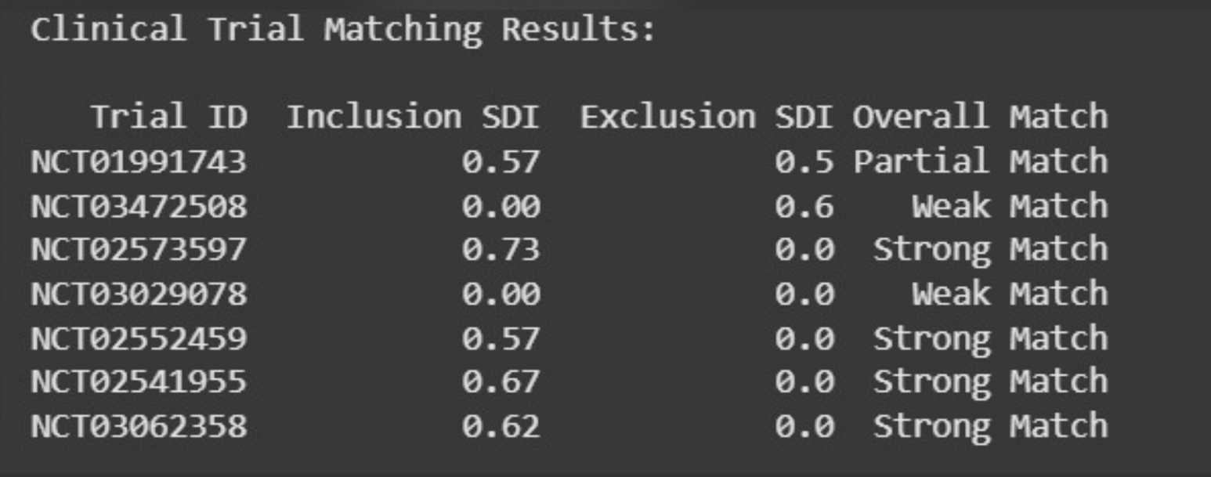
BioBert-NER
RESULT

Slide 25
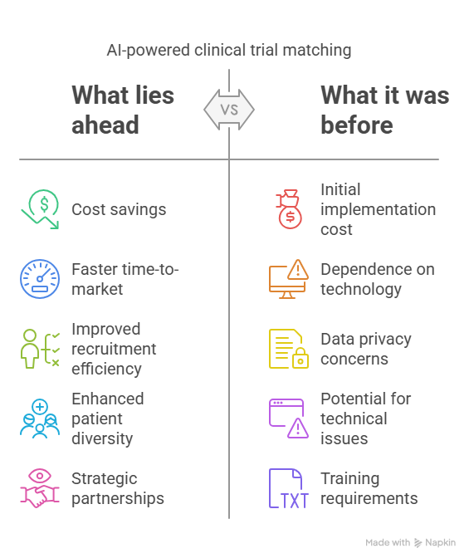
Business Impact

Slide 26
Conclusion
Advanced Predictive Modeling
We utilized meticulous data preparation, exploratory analysis, and ensemble machine learning models to accurately predict recruitment success and optimize participant targeting.
Advanced Predictive Modeling
We utilized meticulous data preparation, exploratory analysis, and ensemble machine learning models to accurately predict recruitment success and optimize participant targeting.
Insights from NLP
By applying natural language processing to unstructured data, we uncovered participant perceptions and barriers to enrollment, enabling the design of tailored and inclusive recruitment strategies.
Impactful Outcomes for Clinical Trials
Our scalable, data-driven framework enhances recruitment efficiency, diversity, and trial integrity, supporting adaptive, evidence-based processes for modern clinical trial management.

Slide 27
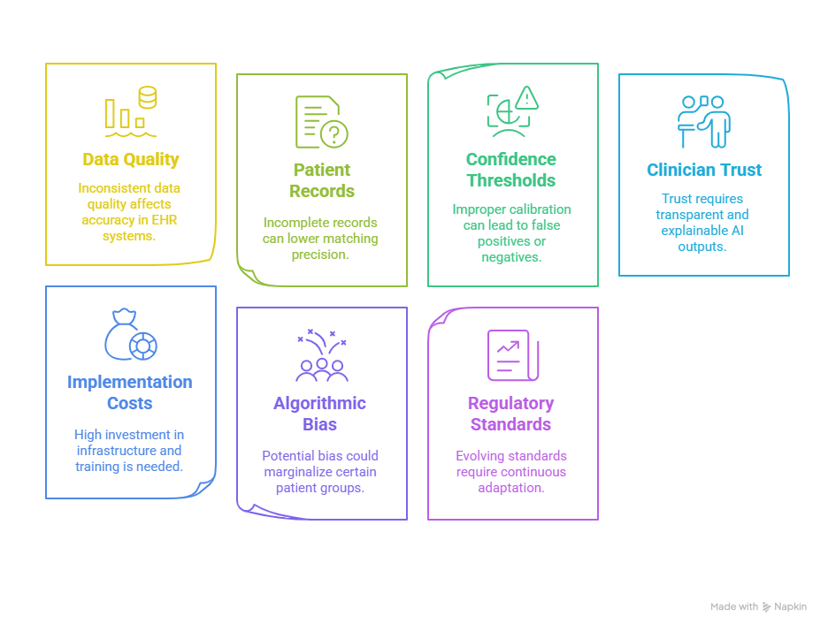
Limitations

Slide 28
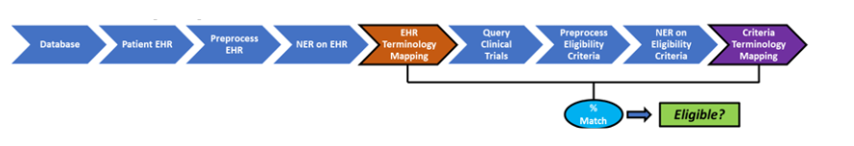
Future work
Future Scope of AI-Driven Clinical Trial Matching:
1. Real-Time Integration
Use of wearables and live monitoring for eligibility tracking Continuous data flow enhances precision
4. Explainable AI for Trust
Transparent models to build clinician confidence
Drives adoption in clinical workflows
2. Genomics & Longitudinal Data
Combine genomic profiles with long-term EHRs
Proactive prediction of trial eligibility
5. Beyond Recruitment
AI to predict dropout risks
Enable personalized patient engagement
3. Global & Multilingual Access
Multilingual support to scale globally
Inclusion of diverse & underserved populations
6. Regulatory Collaboration
Partner with regulatory bodies for validation & compliance Integrate AI tools into
core trial infrastructure

Slide 29
THANK YOU

